Slide 1



Vivanne Hoogendam

Slide 2
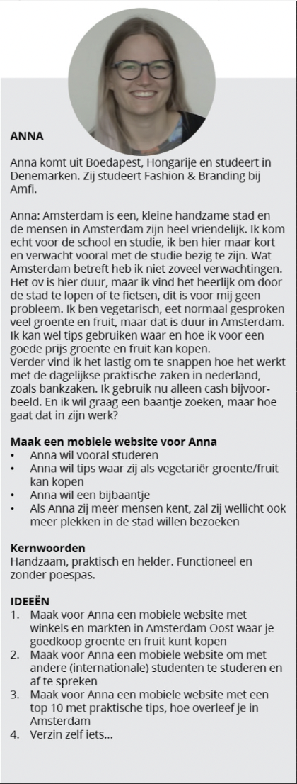

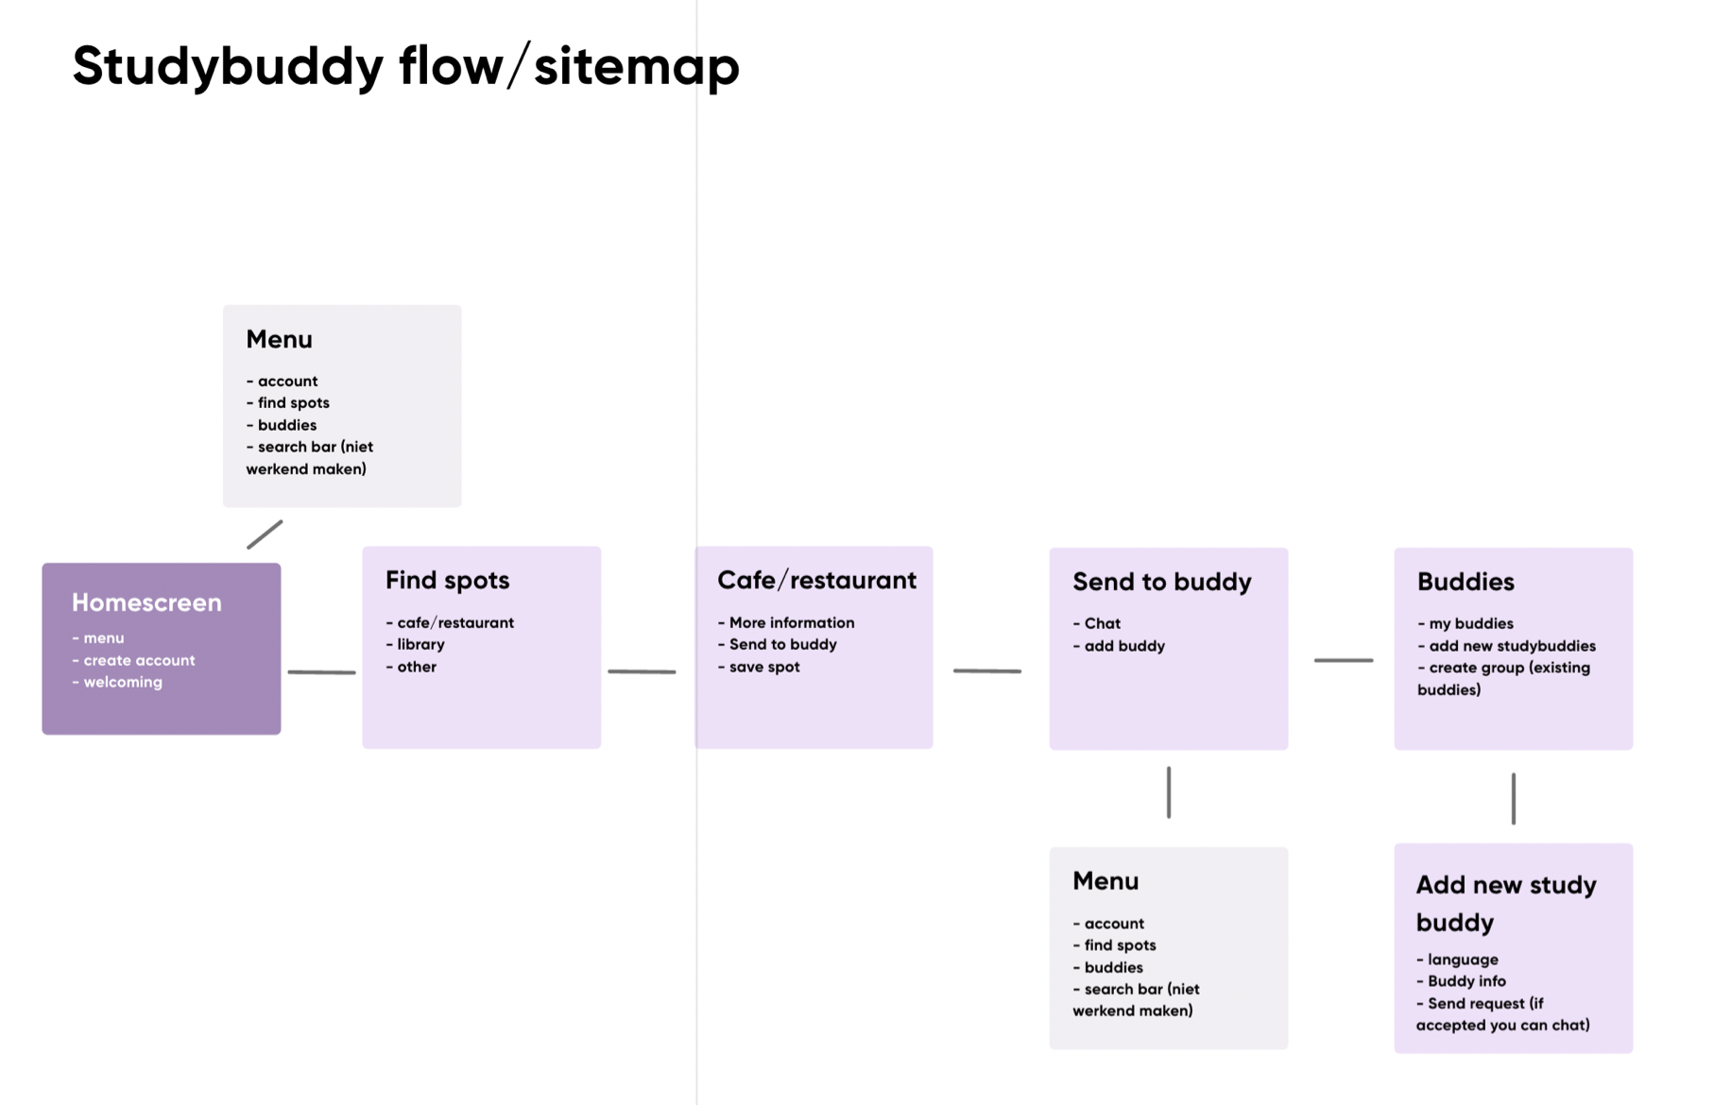
Vivanne Hoogendam
1.
Brainstorm
3 Step process
2. Design
3. Develop

Slide 3
Vivanne Hoogendam
1.
Brainstorm
3 Step process
2. Design
3. Develop

Slide 4
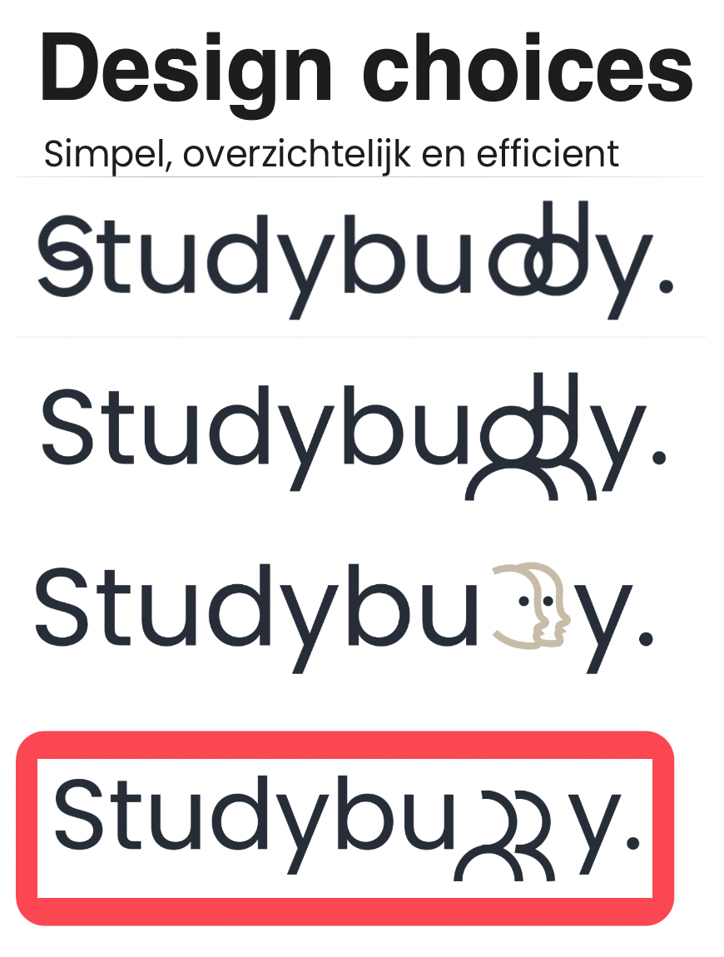
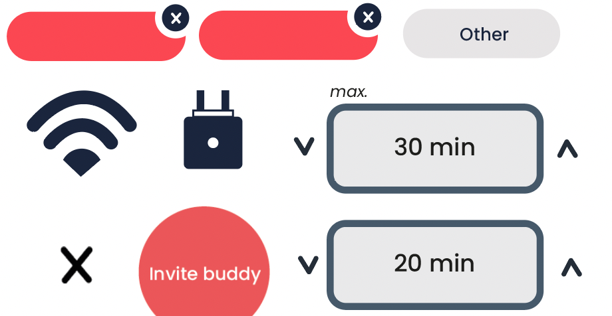


Vivanne Hoogendam
3 Step process
2. Design
3. Develop

Slide 5
Vivanne Hoogendam
3 Step process
2. Design
3. Develop

Slide 6
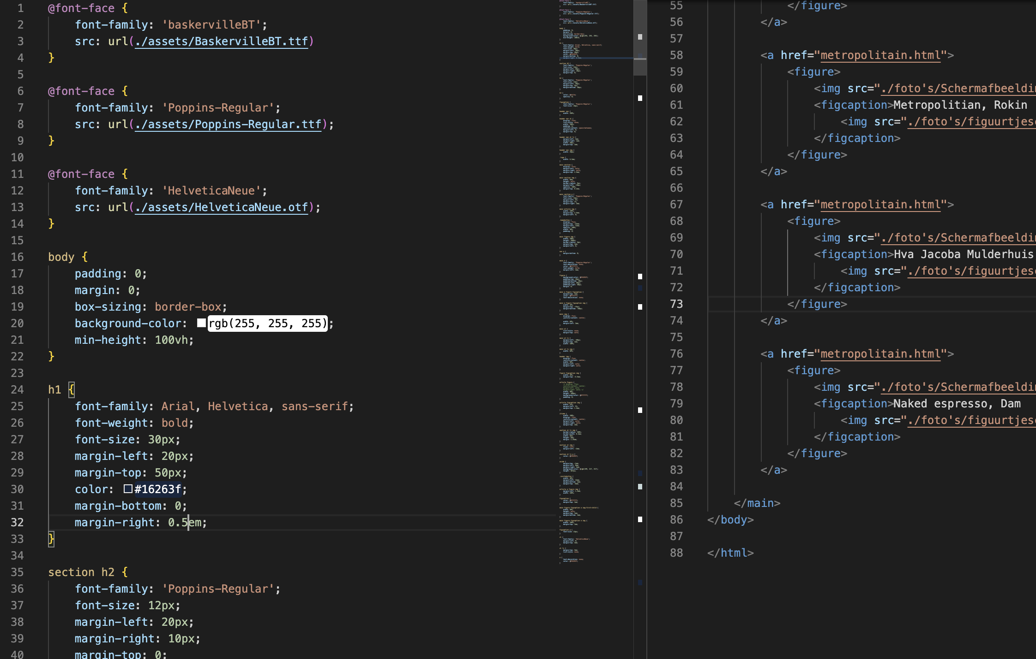
Vivanne Hoogendam
3 Step process
3. Develop

Slide 7
Vivanne Hoogendam
3 Step process
3. Develop

